Slide 1


Conference Room Booking API
Technical Assessment – Omar Bagdadi
Tech stack: Node.js + Express + PostgreSQL

Slide 2
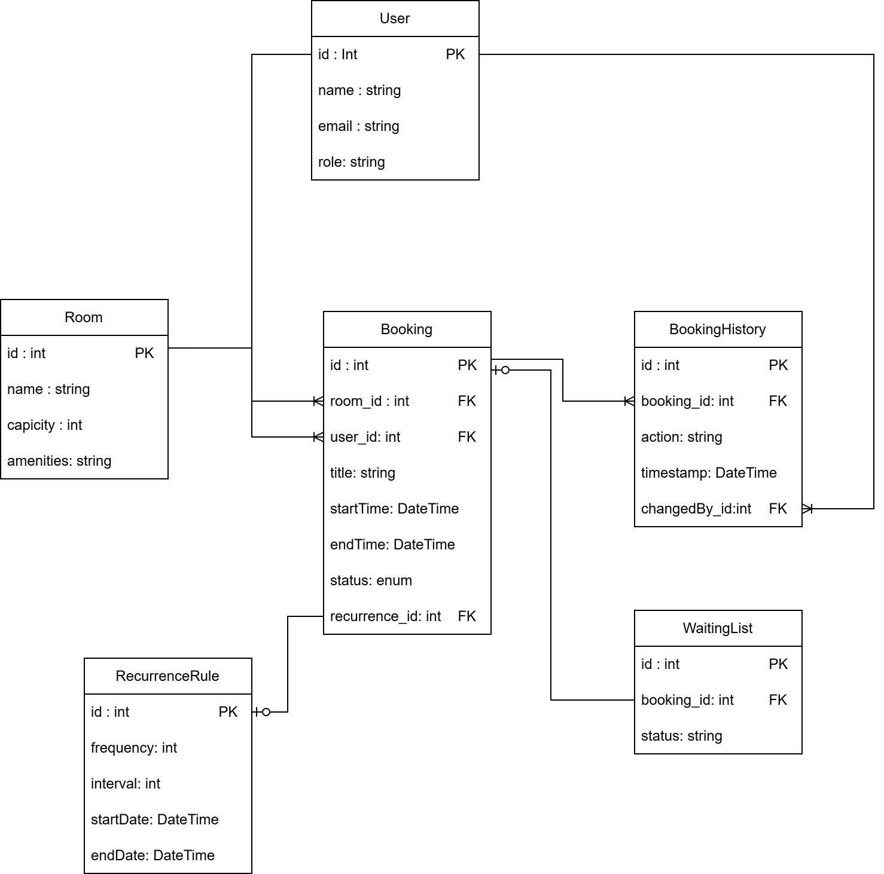
Schema Overview

Slide 3
Core Routes
GET /rooms → List rooms
GET /rooms/filter → Filter rooms by capacity and/or amenities
GET /rooms/:id/availability?date=YYYY-MM-DD → Check availability
POST /bookings → Create booking (validates conflicts, duration, hours)
GET /bookings/:id → Booking details
PATCH /bookings/:id → Reschedule
DELETE /bookings/:id → Cancel booking
GET /users/:id/bookings → User’s bookings

Slide 4
Business Logic & Error Handling
Prevent double‑booking (conflict check + transaction)
Enforce duration (30 min minimum, 4 hr maximum)
Business hours only (9am – 5pm)
Waiting list promotion handled atomically.
Error responses in JSON format with meaningful messages (400, 409, 404)

Slide 5
Scaling & Improvements
Scalability
  Caching queries (Redis).
  Load balancing across containers.
  Auto‑scaling to add/remove containers.
  API pagination.
Deployment
  Docker Compose for dev.
  Docker swarm for scaling in production.
With more time
  Add authorization & authentication.
  Endpoint testing with Jest & Supertest.
  Email notifications.

